Slide 1


Baba Banda Singh Engineering College
Fuel
Efficiency Prediction
Project team:
Sakshi, Sandeep Kumar Yadav, Sahil,
Sahil Dhiman

Slide 2
Project Overview
ML-based system to predict vehicle fuel efficiency
Uses key features: engine size, horsepower, weight, model year, etc.
Trains multiple regression models for accuracy
Streamlit web app for real-time user input and prediction
Results displayed in MPG and km/l
Provides visual graphs for better understanding
Supports fuel-efficient and eco-friendly decisions

Slide 3
Project Objectives
To develop a machine learning model that accurately predicts vehicle fuel efficiency.
To analyze the relationship between vehicle features and fuel consumption.
To provide real-time fuel efficiency prediction through a user-friendly Streamlit web app.
To display results in both MPG and km/l for better usability in India.
To compare multiple ML models and select the most accurate one.
To support environment-friendly and fuel-efficient driving decisions.

Slide 4
Literature Insights on ML Models
ML outperforms traditional statistical methods
Handles complex, non-linear relationships in data
Regression models widely used (Linear, Random Forest, Gradient Boosting)
Auto MPG is a common benchmark dataset
Feature engineering improves model accuracy
Most studies lack real-time deployment — our project provides it

Slide 5
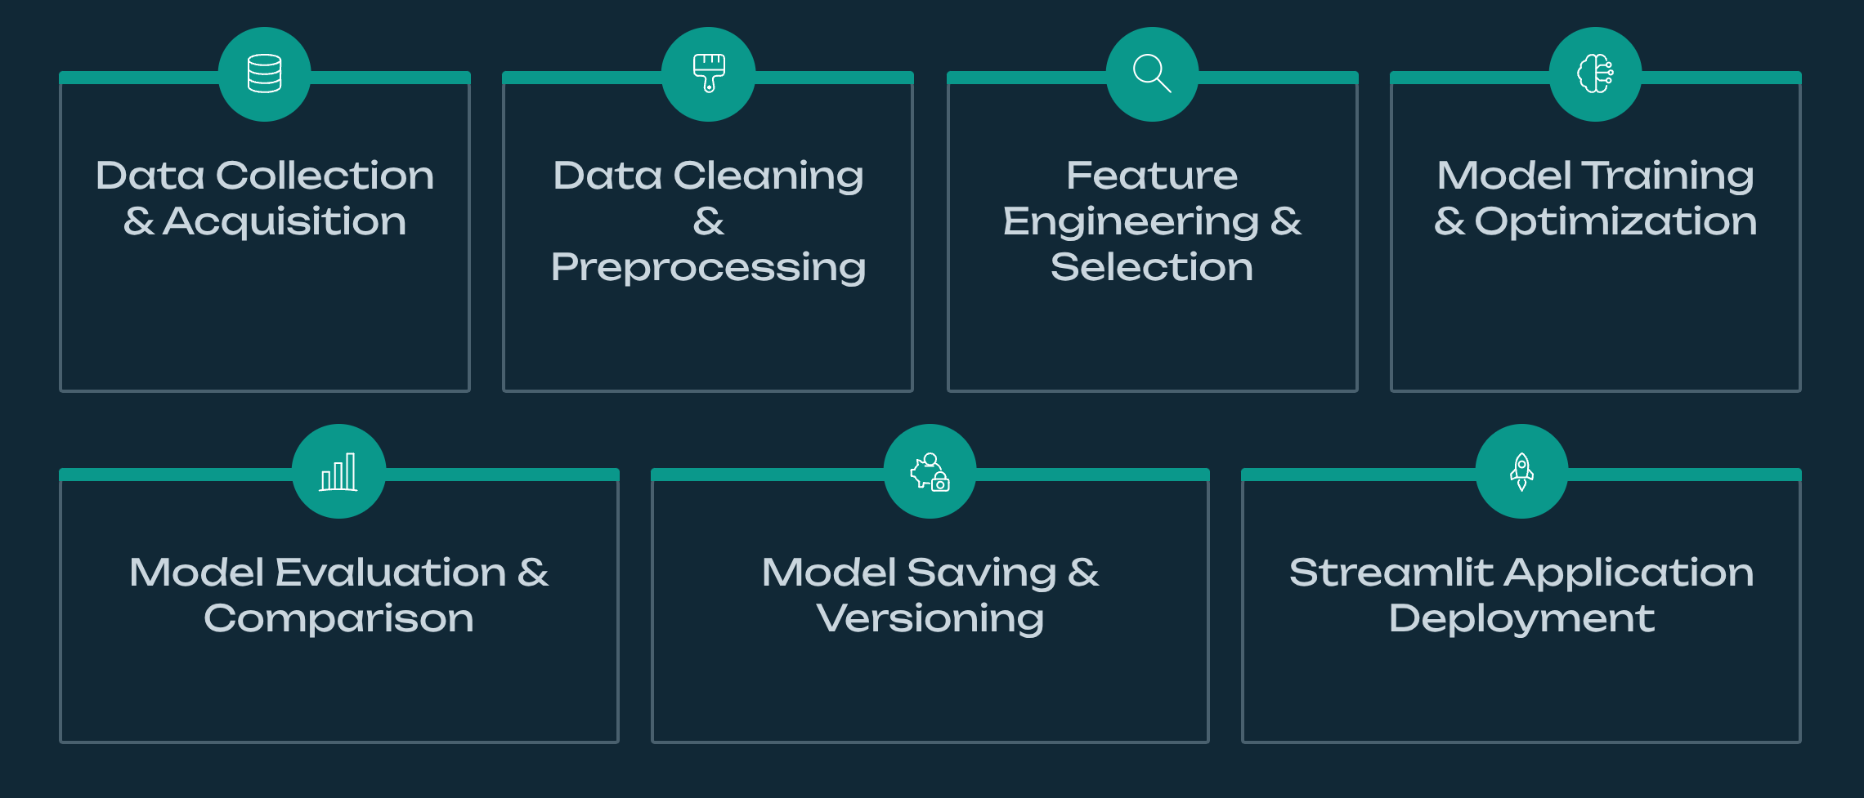
Methodology Overview

Slide 6
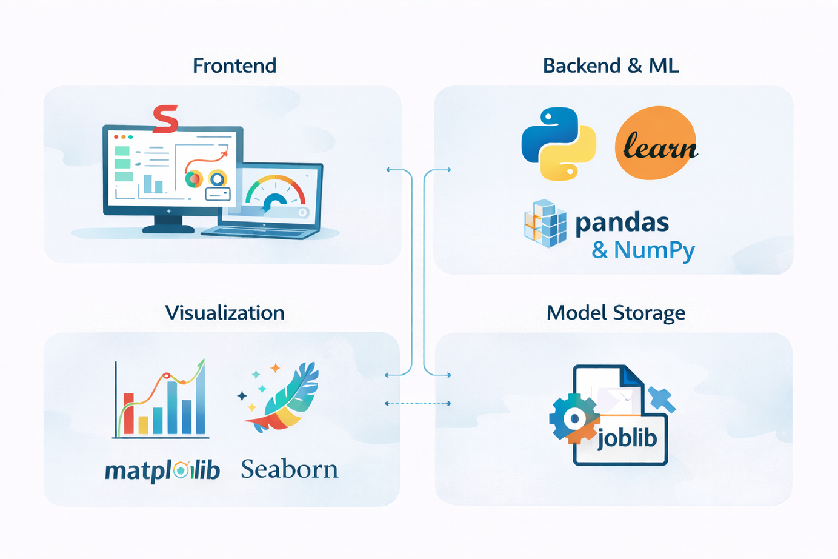
Technologies
Used

Slide 7
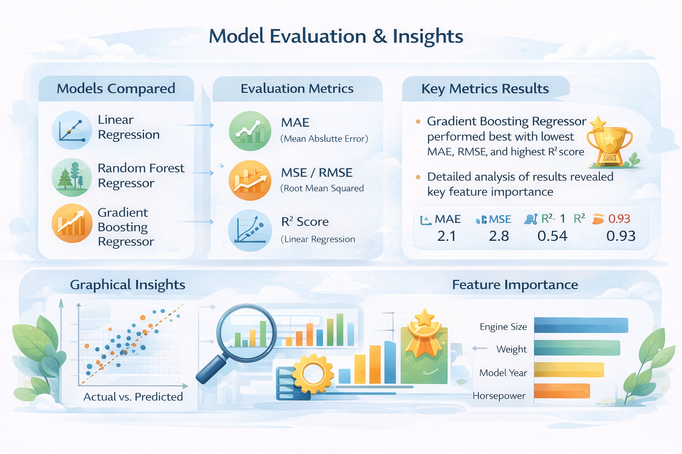
Model
Evaluation
and
Insights

Slide 8
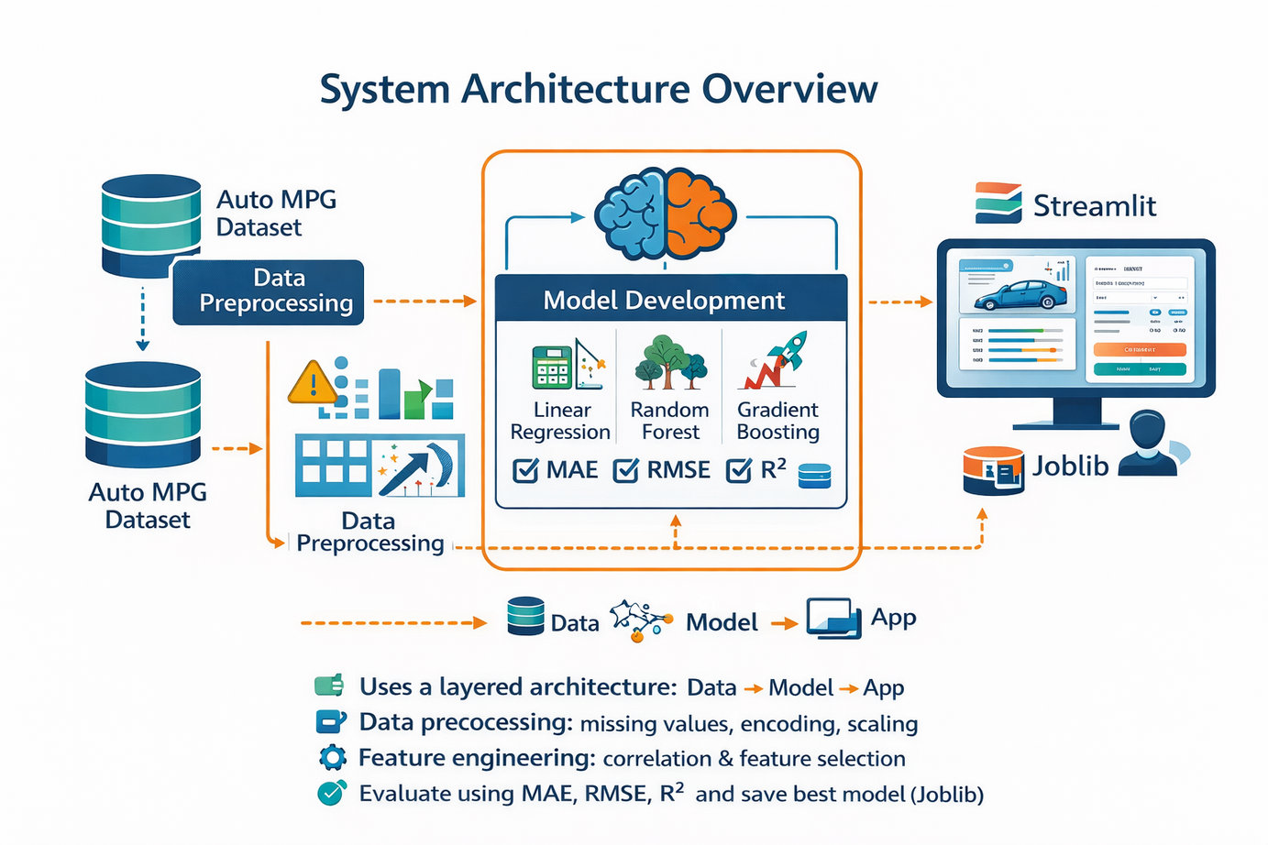
System
Architecture
Overview

Slide 9

Key Project Outcomes
Accurate prediction of vehicle fuel efficiency
Comparison of multiple ML models and selection of best one
User-friendly Streamlit web application for real-time prediction
Results shown in MPG and km/l
Visual graphs for better interpretation of results
Reliable model saved using Joblib for reuse
Supports fuel-efficient and eco-friendly decision making

Slide 10
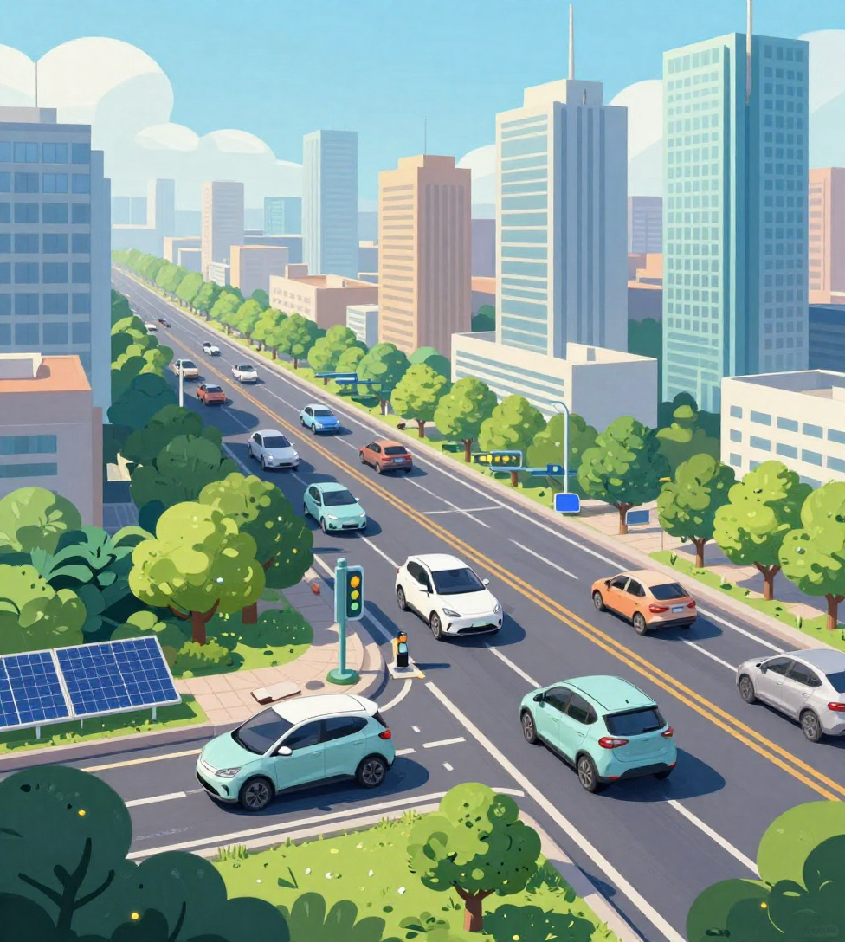
Future Impact of Fuel Efficiency
Reduced fuel consumption and cost for users
Lower carbon emissions, helping the environment
Promotion of sustainable transportation
Encourages development of smarter, energy-efficient vehicles
Supports government policies on energy conservation and climate change
Helps manufacturers design lighter and more efficient engines
Benefits urban air quality and public health

Slide 11
1. S Yoo, J Shin, SH Choi - Scientific Reports, 2025 - nature.com. " Machine learning vehicle fuel efficiency prediction." Scientific Reports volume 15, Article number: 14815 (2025) 2. Zhang, Y., et al. (2025). Machine learning-based prediction of vehicle fuel consumption and Efficiency using real-world driving data. Scientific Reports, Nature. 3. Li, X., et al. (2025). Data-driven approaches for vehicle fuel efficiency analysis and sustainability assessment. Sustainability, MDPI, 17(6), 2395. 4. Breiman, L. (2001). Random Forests. Machine Learning, 45(1), 5–32. 5. Friedman, J. H. (2001). Greedy function approximation: A gradient boosting machine. Annals of Statistics, 29(5), 1189–1232. 6. Hastie, T., Tibshirani, R., & Friedman, J. (2009). The Elements of Statistical Learning: Data Mining, Inference, and Prediction. Springer. 7. UCI Machine Learning Repository (2023). Auto MPG Dataset. Retrieved from: https://archive.ics.uci.edu 8. Pedregosa, F., et al. (2011). Scikit-learn: Machine learning in Python. Journal of Machine Learning Research, 12, 2825–2830. 9. Streamlit Documentation (2024). Building Data Apps in Python. Retrieved from: https://docs.streamlit.io
References

Slide 12


Thank You

